Slide 1
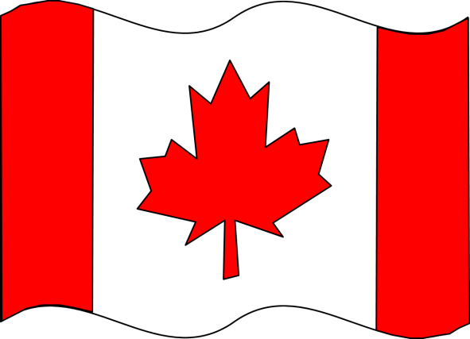
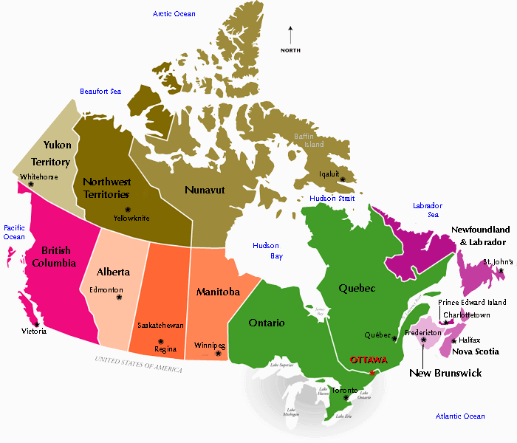
Canada
My book about
Name:_______________

Slide 2
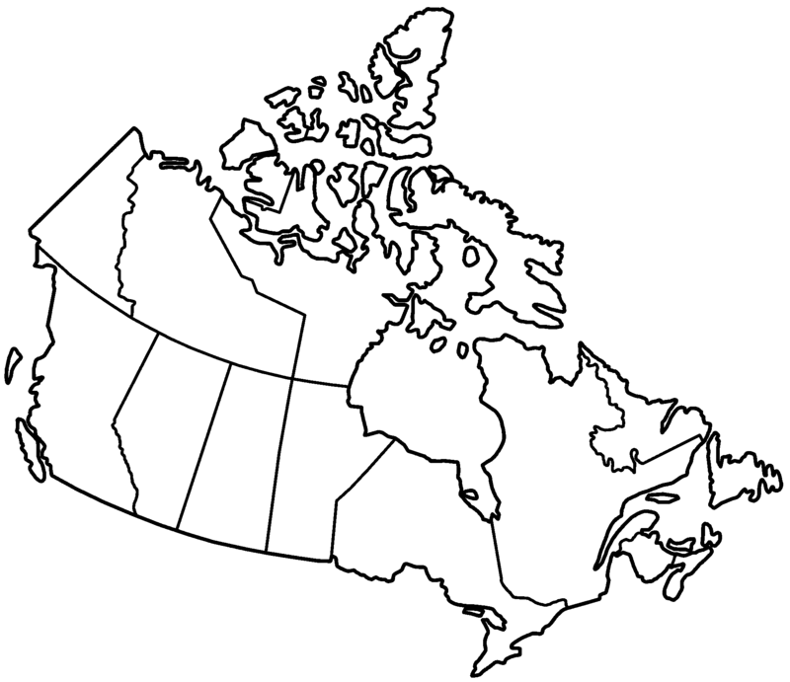
Canada
My book about
Name:___________________

Slide 3
Canada is the 2nd ________________ country in the ___________________!
Canada has ________ provinces and ___________ territories.
My province is: ___________________
My city is: _______________________

Slide 4
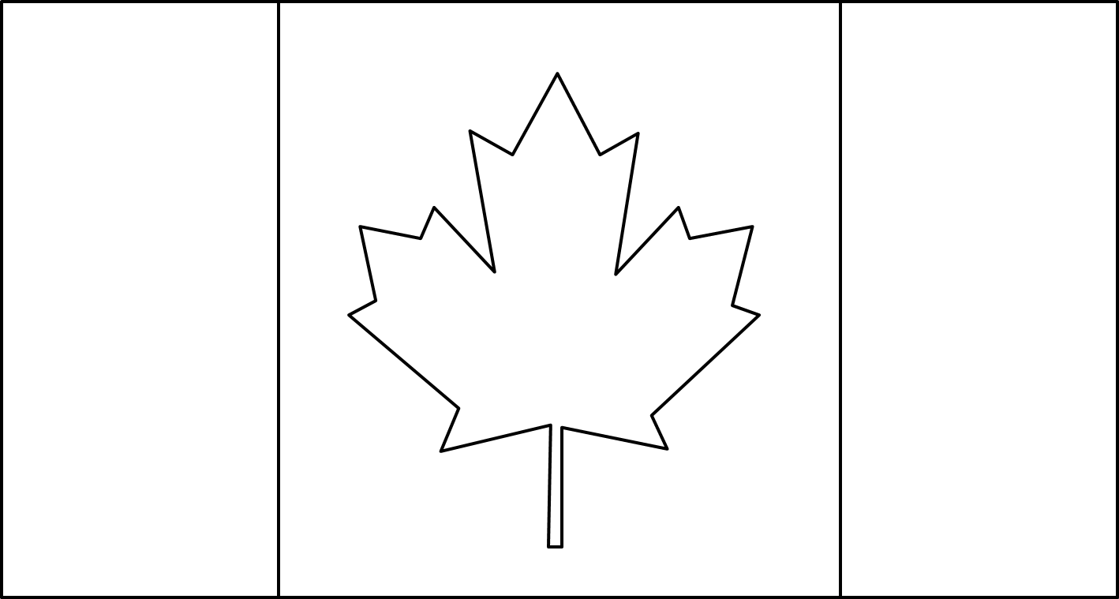
This is the Canadian ______________.
The Canadian Flag has a ___________ background with ___________ stripes on both sides.
It has a red _____________ leaf in the middle.

Slide 5
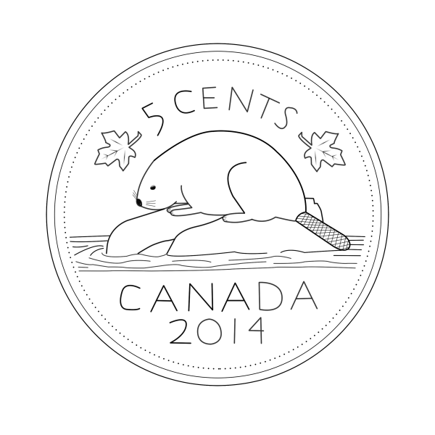
This is a _____________ leaf. It is a symbol of Canada that is found on the Canadian Flag.
This is a _______________. It is a coin worth _______ cents. The animal on the nickel is called a ________. The beaver is another symbol of Canada.

Slide 6
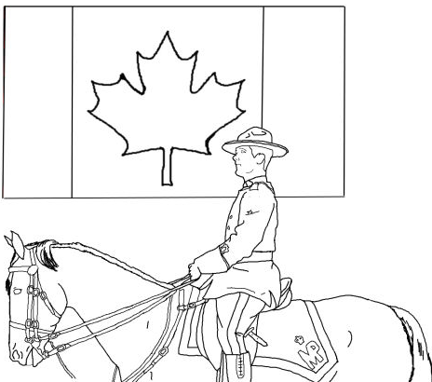
RCMP stands for
_________________ _______________ _________________ ______________.
Sometimes members of the RCMP are called _______________________.
Mounties help keep us safe.

Slide 7
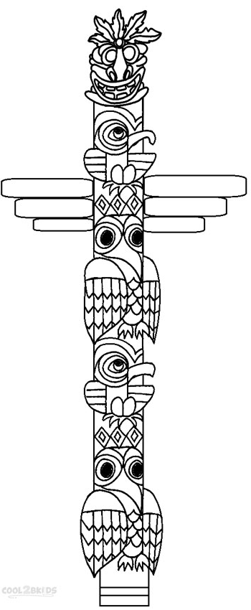
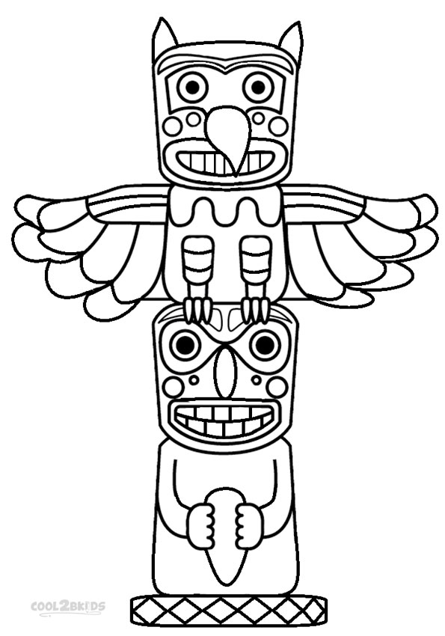
These are called __________________
poles. Totem poles are carved out of
wood. They are made by ______________________ peoples. The animals and symbols on totem poles tell stories.

Slide 8
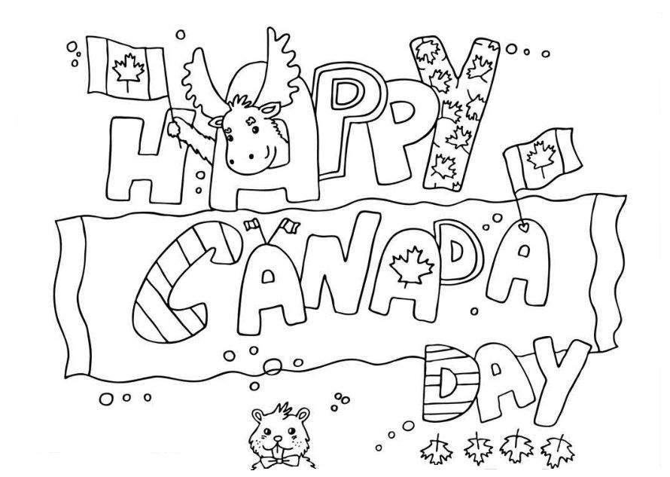
Canada’s birthday is called Canada Day. It is celebrated on ____________ ______.
Canada became a country in 1867. This year, Canada is ________ years old.

Slide 9
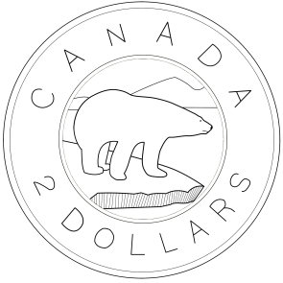
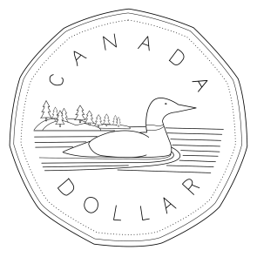
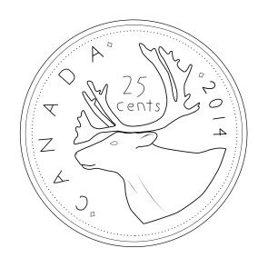
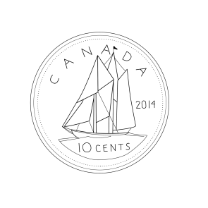
Here are the Canadian coins:
This is called a _____________ It is worth ______ __________
This is called a _____________ It is worth ______ __________
This is called a _____________ It is worth ______ __________
This is called a _____________ It is worth ______ __________
This is called a _____________ It is worth ______ __________
This is called a _____________ It is worth ______ __________

Slide 10
O Canada!
Our home and native land.
True patriot love
In all of us command.
With glowing hearts we see thee rise,
The True North strong and free!
From far and wide, O Canada,
We stand on guard for thee.
God keep our land glorious and free!
O Canada, we stand on guard for thee.
O Canada, we stand on guard for thee.
“O Canada” was first sung on June 24, 1880 but it was not proclaimed Canada’s national anthem until July 1, 1980 – 100 years later!

Slide 11
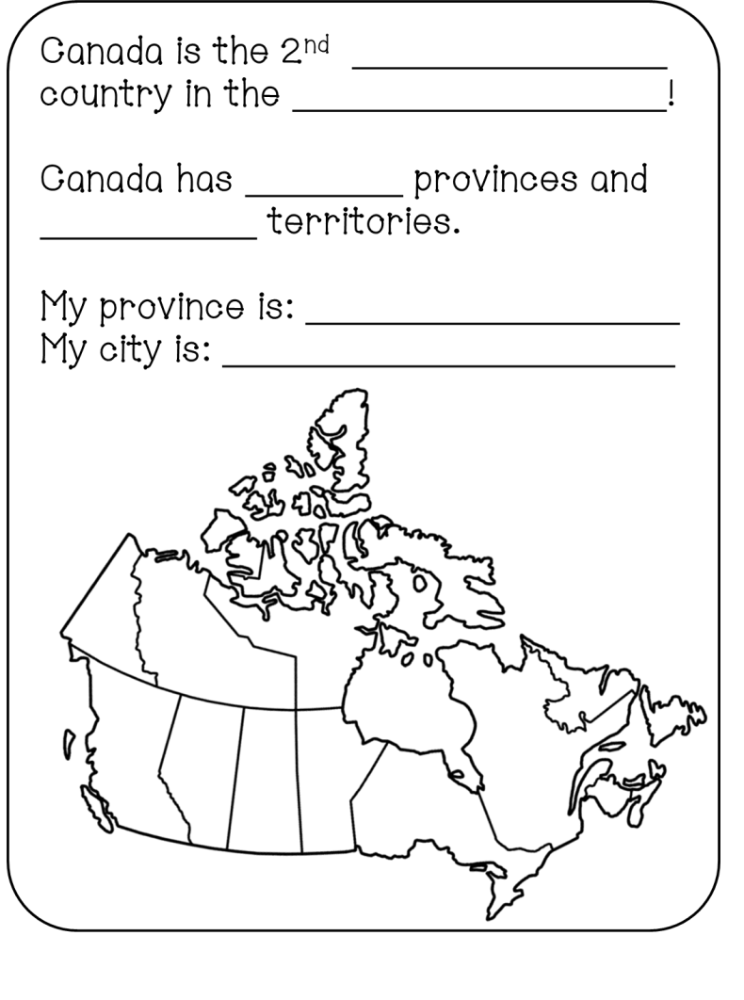
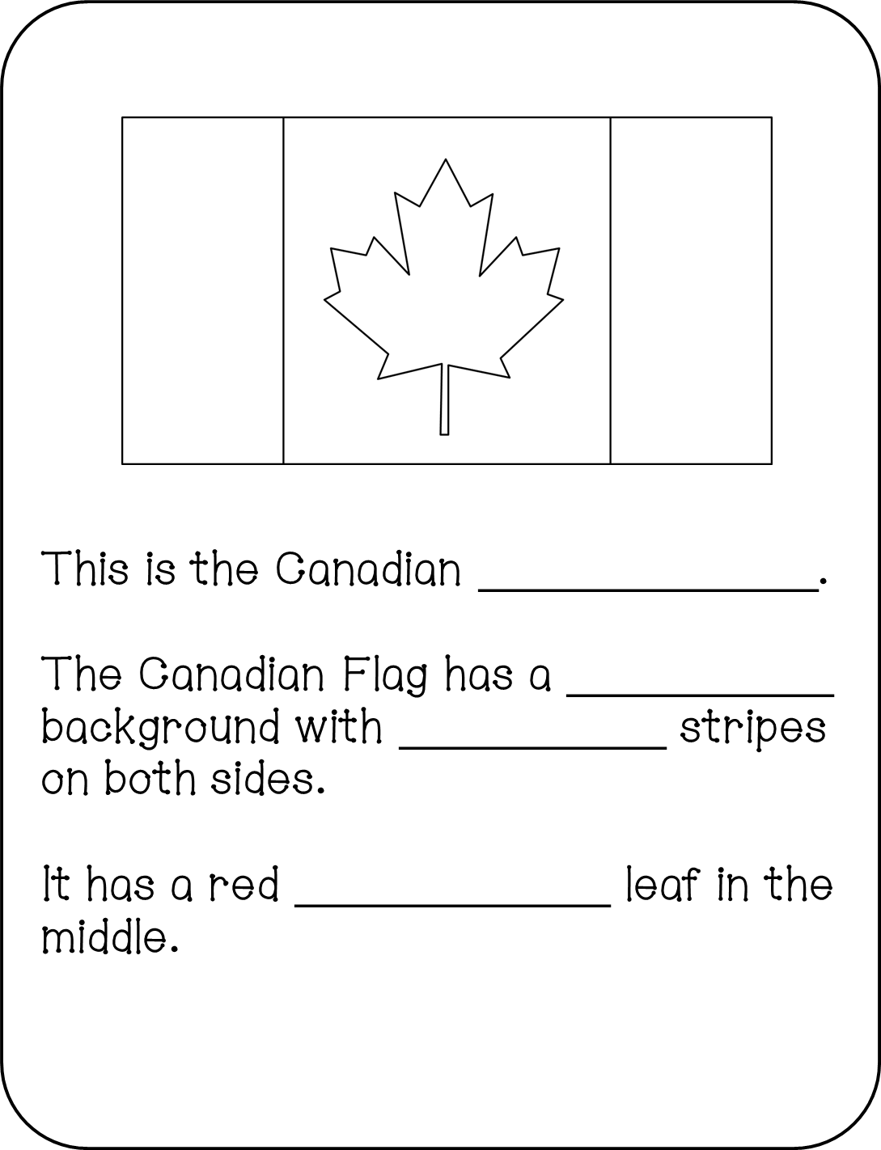
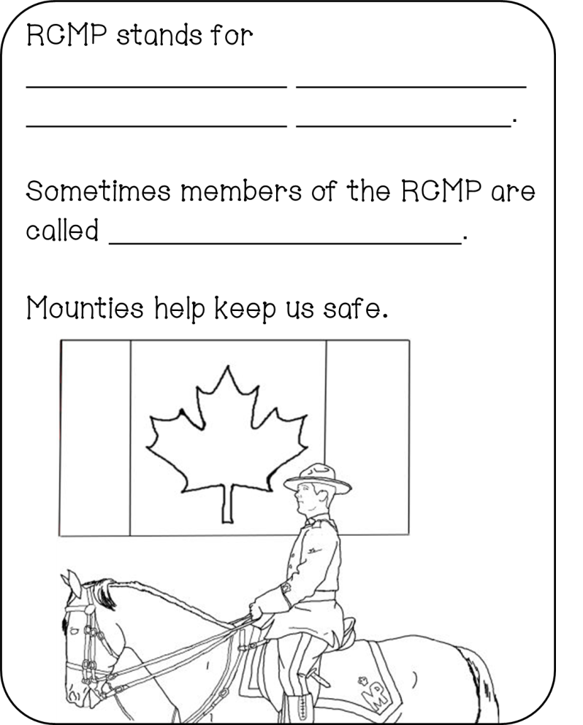
Answer Keys
largest
world
10
3
flag
white
red
maple
maple
Royal Canadian
Mounted Police
mounties
nickel
five
beaver

Slide 12
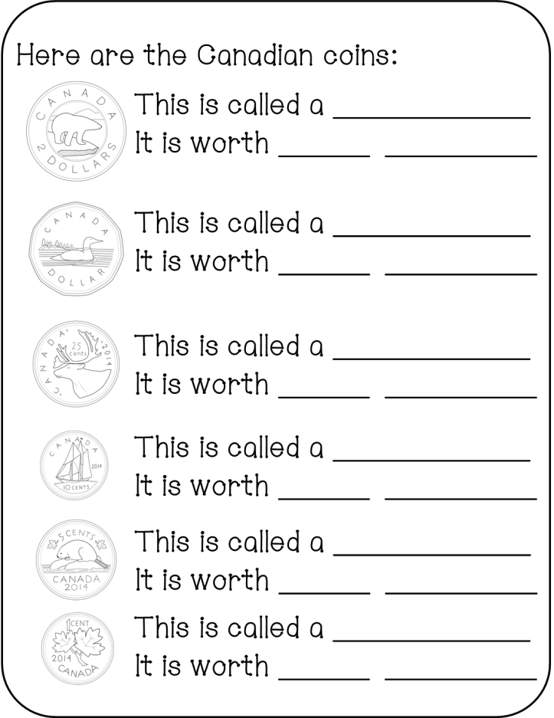
totem
Aboriginal
July
1st
toonie
2 dollars
loonie
1 dollar
quarter
25 cents
dime
10 cents
nickel
5 cents
penny
1 cent

Slide 13
Thank you for downloading this pack.
Follow my store for notifications of new products, discounts, sales, and freebies.
http://www.teacherspayteachers.com/Store/One-Teachers-Adventures
Follow me at:
http://www.oneteachersadventures.blogspot.ca

